Slide 1
Linguistics and Geography
By Koffi Alavo, Chauncey Becker, Rohit Kunte, and Austin Simmer
Notes:
Koffi

Slide 2

Introduction
Focus on linguistics and the commonalities and differences between languages.
Our goal is to analyze syllables that are used in multiple languages, finding which continents favor which syllables.
Notes:
Koffi
For our project, we wanted to focus on linguistics and the commonalities and differences between languages, this will help us identify where they’re spoken.
More specifically, our goal is to analyze syllables that are used in multiple languages, and gain insight into which continents favor which syllables.

Slide 3
Why does this topic interest us?
Uncommon project topic
Personal interest
Interpreting this data is challenging
Notes:
Chance
Linguistics was inherently interesting to us because none of us have seen a collection of linguistics data before.
We knew that although the data may be difficult to analyze, by combining what we’ve learned in class with our personal interests. We would be able to adequately analyze the data.
It’s COOL!

Slide 4
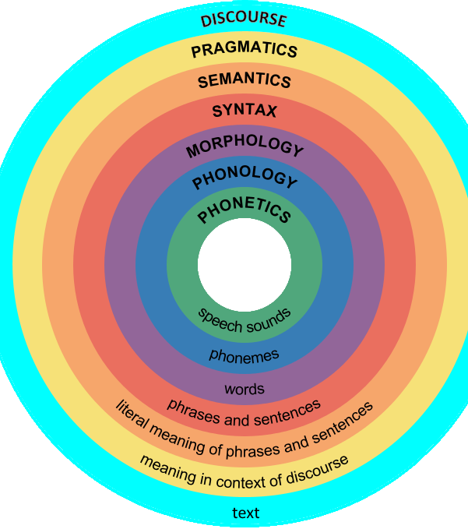
Linguistics?
What is Linguistics?
How are languages around the world similar?
Analyzing language syllables
Notes:
Chant
What is Linguistics?
Study of language and its structure, includes morphology, syntax, phonetics, and semantics, etc.
How are these languages around the world similar?
The answer may be found in analyzing language syllables.
Talk about the graphic to the right

Slide 5
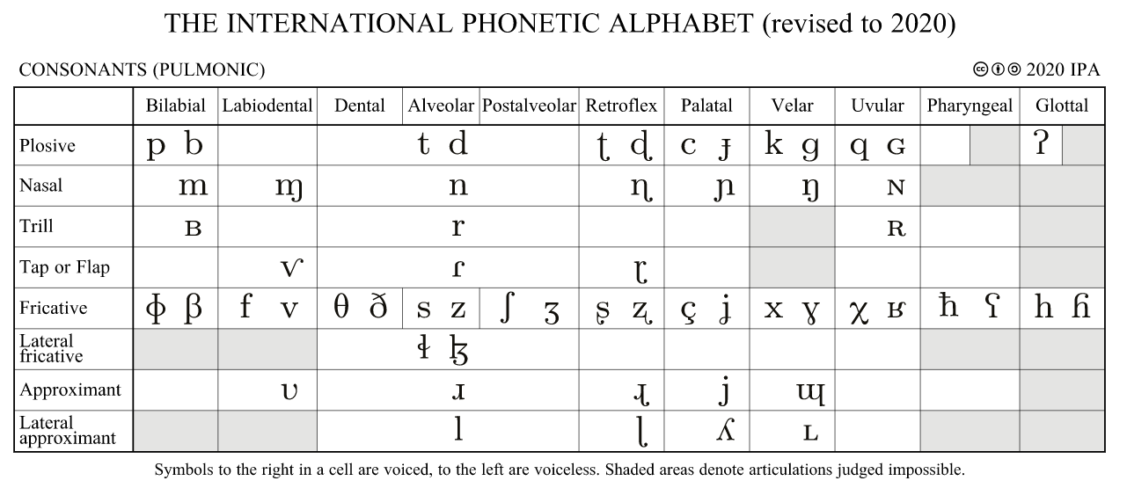
Notes:
Chance

Slide 6
Our Sources
The data is from UCLA Phonological Segment Inventory Database
http://www.linguistics.ucla.edu/faciliti/sales/software.htm#upsid
Unfortunately, the database was tarnished. Luckily, Scholars from Geothe University Frankfurt, in Germany saved the database
http://www.linguistics.ucla.edu/facility/sales/upsid
We used the following source to map countries and continents
https://www.ethnologue.com/codes/LanguageIndex.tab
Mapping for tracking languages and their whereabouts can be found on Wikipedia
https:// en.Wikipedia.org/wiki/List_of_language_families
Notes:
Austin
The data we will be using comes from the UCLA Phonological Segment Inventory Database
http://www.linguistics.ucla.edu/faciliti/sales/software.htm#upsid
Unfortunately, the database was tarnished. Luckily, Scholars from Geothe University Frankfurt, in Germany saved the database and we pulled from it here
http://www.linguistics.ucla.edu/facility/sales/upsid
We used the following source to map countries and continents
https://www.ethnologue.com/codes/LanguageIndex.tab
Mapping for tracking languages and their whereabouts can be found on Wikipedia
https:// en.Wikipedia.org/wiki/List_of_language_families

Slide 7
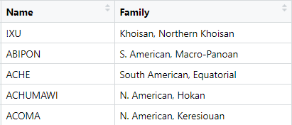
Our Original Database – “Compiled”
Notes:
Austin
We took data on 451 languages and mapped all the syllables each language uses.
Our first data frame we created was called “compiled” this consisted of two columns called “Name” and “Family”.
“Name” – The name of each specific language to be analyzed.
“Family” – The family of languages that each specific language belongs too.
At this point, we have a full list of each language and what family they belong too. This will be instrumental in identifying similarities between “families” and mapping them to their geological regions.

Slide 8
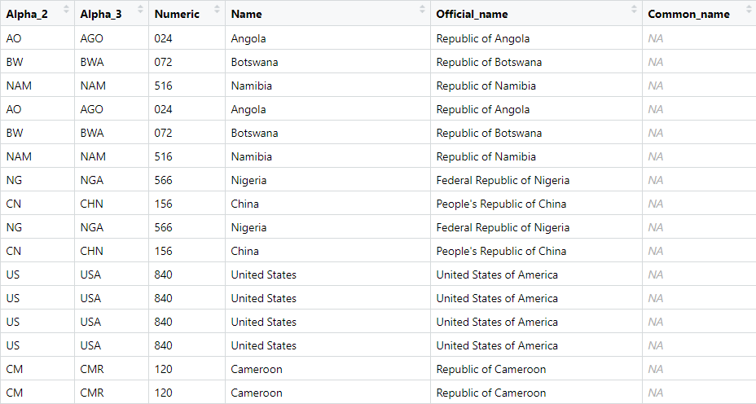
New Table – “Countrymap”
Notes:
Austin
After constructing our original database. We realized that we needed to compile a new table/dataframe that will allow us to identify all the countries in the world.
As you can see, we created a table that consisted of 6 variables. Alpha_2, Alpha_3, Numeric, Name, Official Name, and Common Name.
Alpha_2 is an abbreviation of the country name that was referenced off of in other datasets.
Alpha_3 is a secondary abbreviation of the country name that was used occasionally as a replacement or alternative to Alpha_2
Numeric is the number code that identifies the country name.
Lastly, Name is the country name, with the official name and common name being variations of the country name.

Slide 9
Our Findings
Continent with the most languages – Africa
Most languages spoken in a country – Papua New Guinea
Continent with fewest number of different languages – Europe
Oceania has more spoken languages than N/S America combined!
Notes:
Rohit
Our findings concluded with a few very interesting findings.
When observing which continents have the greatest number of languages, Africa has over 150 different languages which was more than any other continent.
The country with the most spoken languages spoken by its population is Papua New Guinea.
The continent with the fewest number of different languages was Europe.
As we did not have a strong understanding of what our results would be due to the limited understanding of linguistics. We were surprised that Europe had the least number of languages, and that Africa had the most. We had assumed that since Asia takes up the most land space, that it would have the greatest number of different languages spoken in them.
Our final interesting finding was that the Oceania continent actually had more spoken languages in it then North and South America combined.

Slide 10

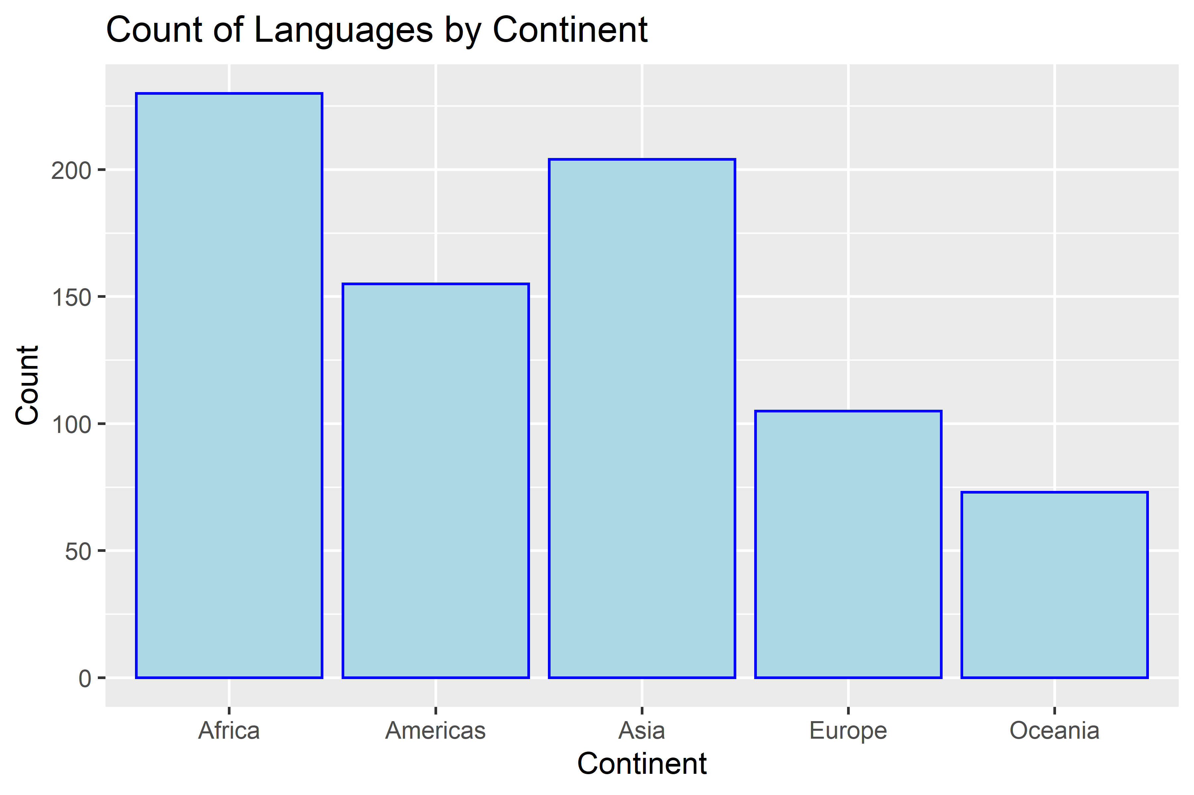
Notes:
Koffi
Talk about the graph:
X axis
Y axis
Findings

Slide 11
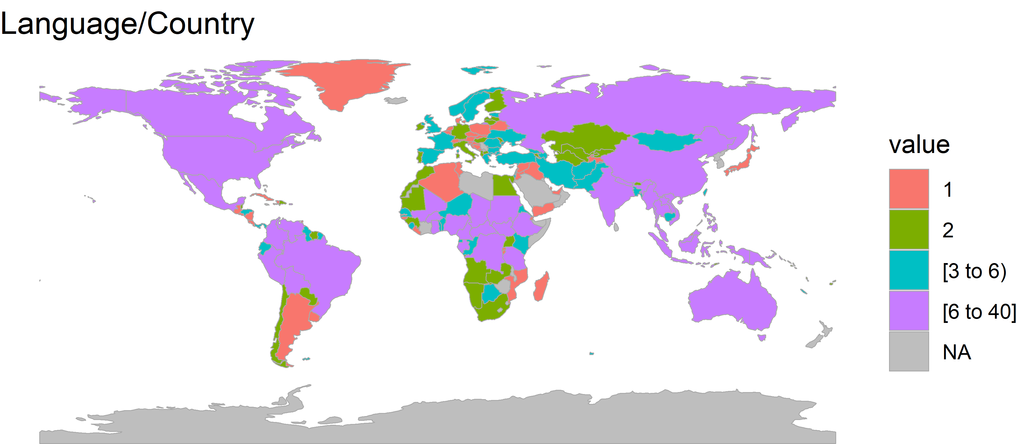
Notes:
Koffi
May need to sub out for another graphic? Not sure if this is the one we want to use.

Slide 12
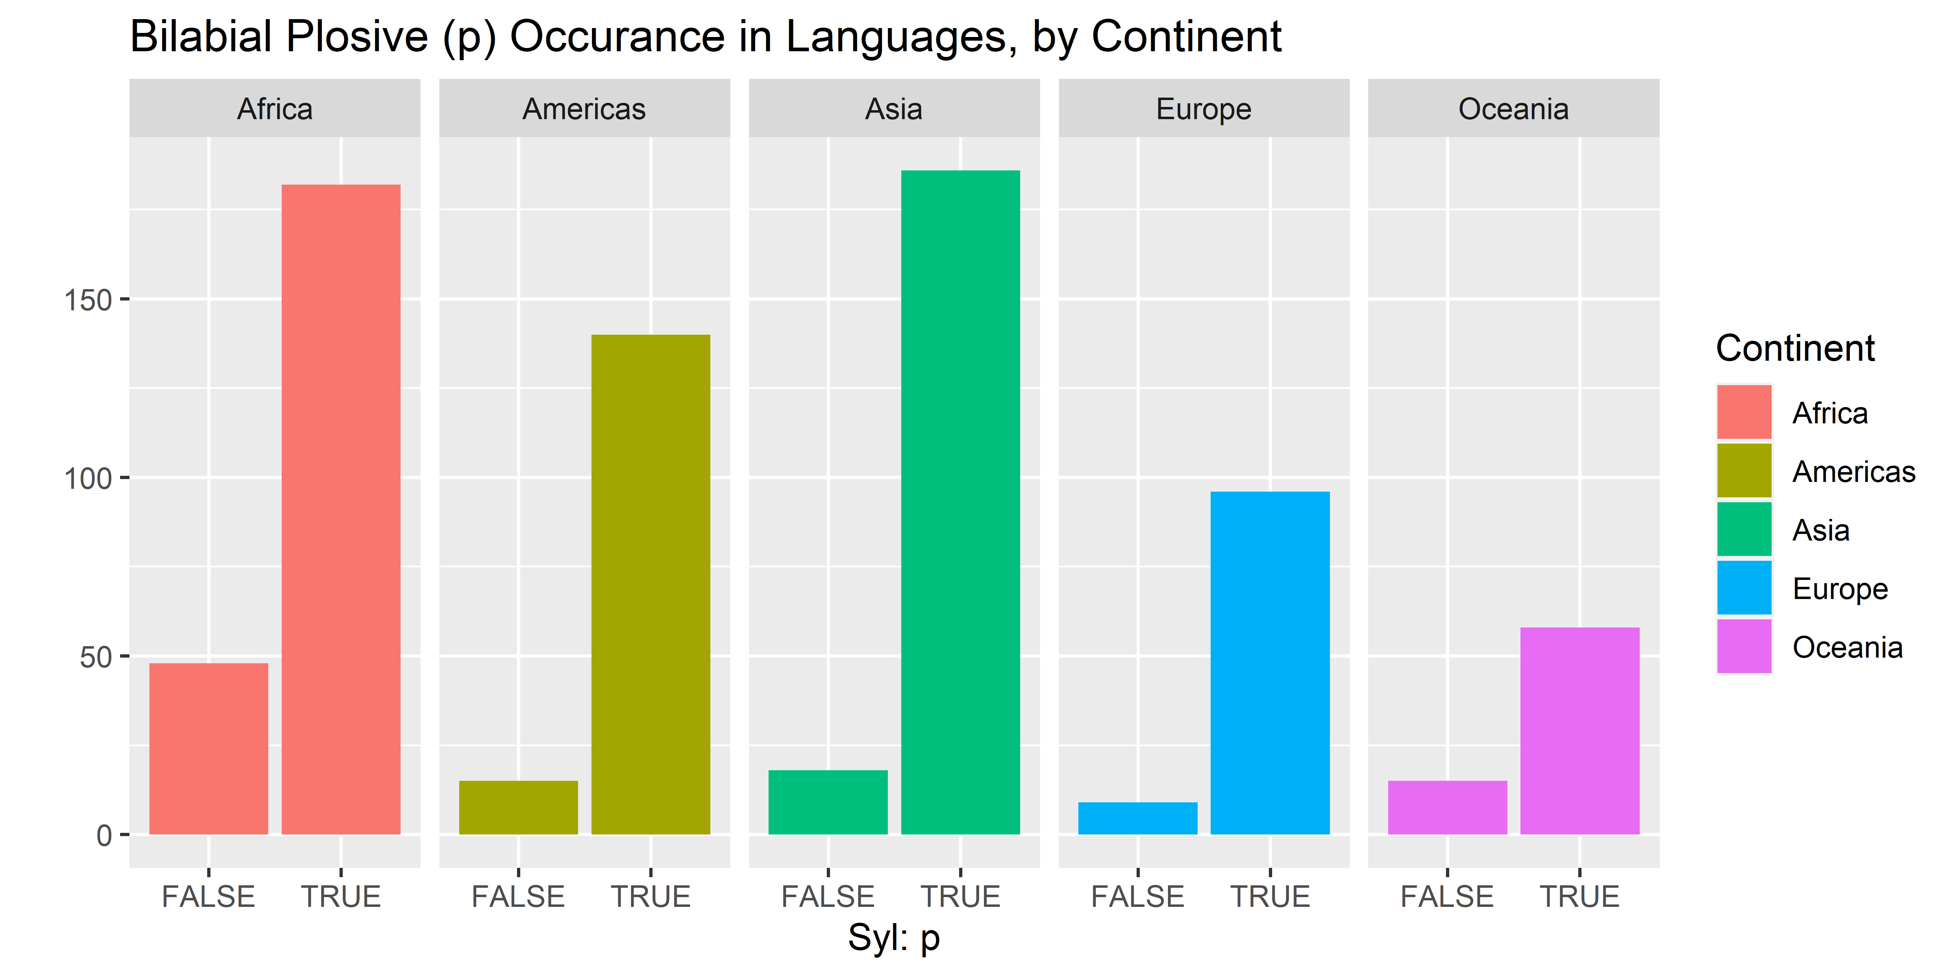
Notes:
Koffi
Common syllable (“p” sound) occurrence in continents
Present in lots of languages, though less so in Africa

Slide 13
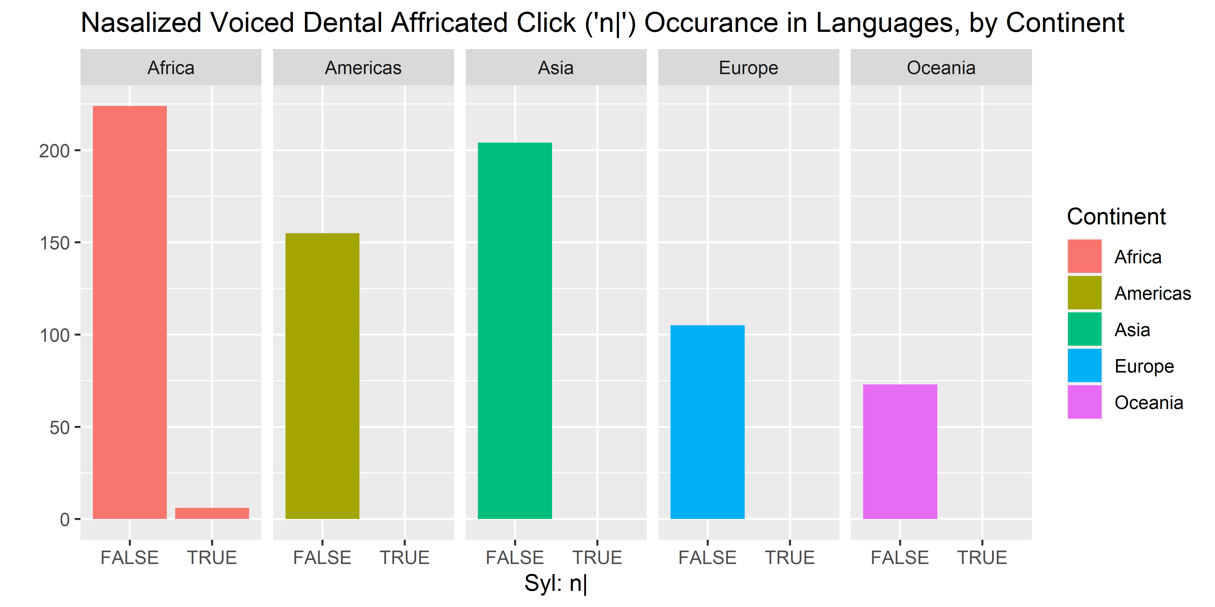
Notes:
Koffi
Very uncommon syllable (“tongue click” sound) occurrence in continents
Only present in very small number of languages in Africa, not anywhere else

Slide 14
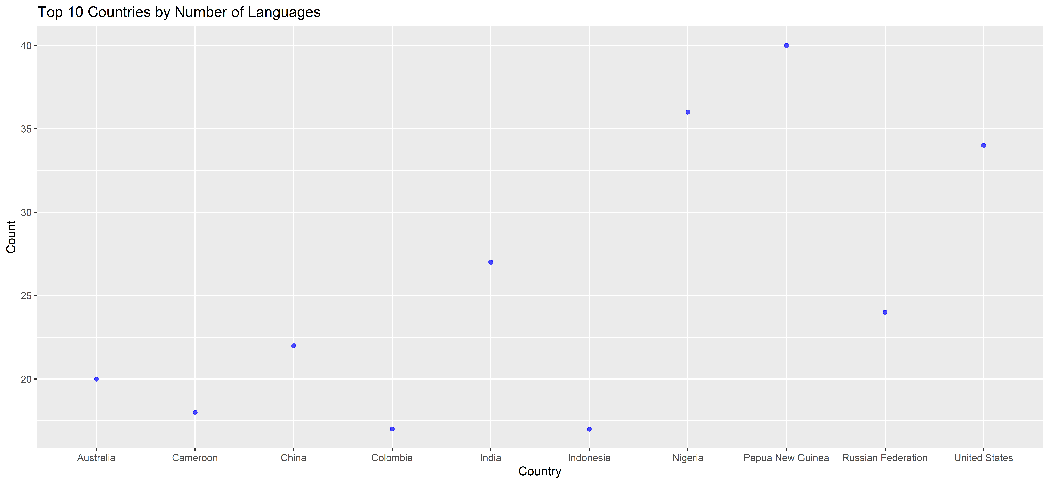
Notes:
Koffi
Talk about the chart:
X axis
Y axis
Findings
(Note: we couldn’t get a bar graph to work with this data, so we had to settle for a scatter plot)

Slide 15
Interaction Time
What do you want to see?
Notes:
Rohit
Show off shiny apps

Slide 16
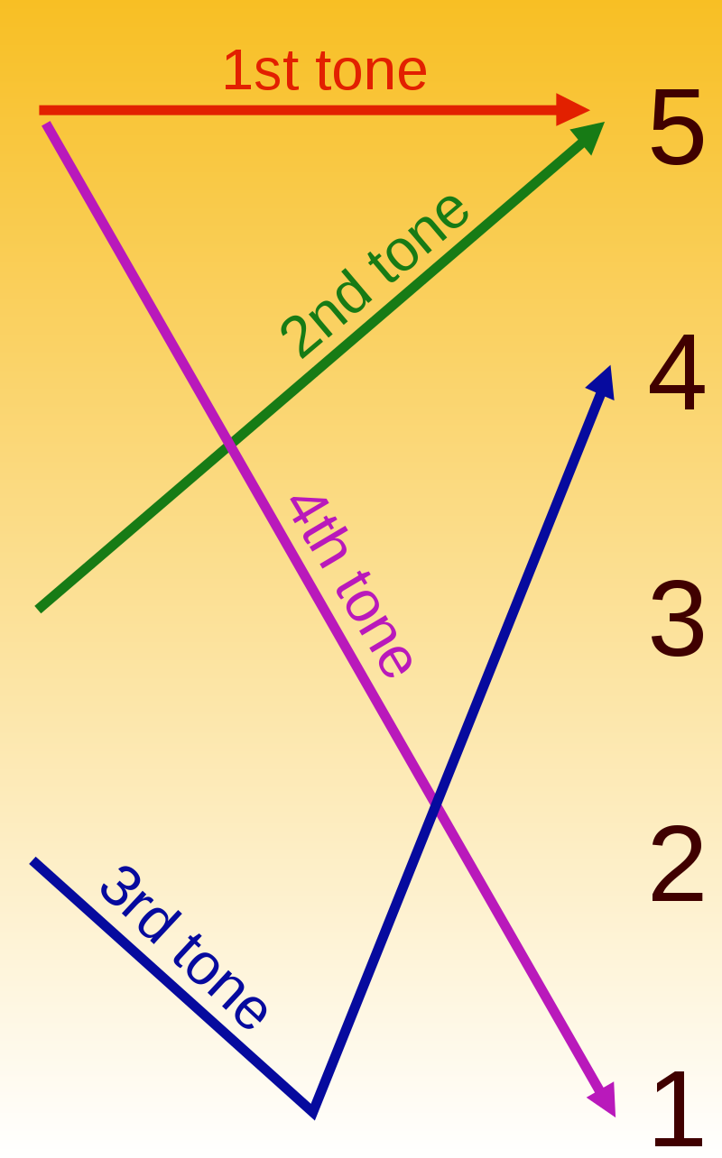
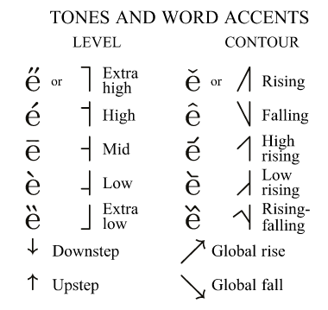
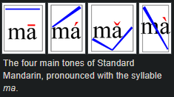
Improvements
Include all countries
Sound samples / links to sound samples
Add proper syllable names
Tones
Notes:
Chance
Add proper syllable names to our data (e.g. “p” is associated with “voiceless bilabial plosive”)
Find, clean and process data for ALL countries (Korean Peninsula, Saudi Arabia, others were not included in our existing data)
Include/link to sound sample of the syllable within our data
Denote tonal languages, and what tones are possible

Slide 17
What did everyone work on?
Chance – Created the project proposal, extracted the languages and syllables from hundreds of files.
Koffi – Created summary tables, decided how to clean the data. Constructed visualizations to use in our presentation.
Rohit – Executed cleaning of the data, built interactive reports, and helped with data visualizations.
Austin – Attempted to create data frames that combined multiple sources. Created our dry-run presentation as well as our final presentation.
Notes:
Chance

Slide 18
Questions?
Notes:
Chance

